Slide 1

Reconocimiento de Patrones
Domingo Mery
Departmento de Ciencia de la Computación
Escuela de Ingeniería
Universidad Católica de Chile
Semestre 2016-1
Deep Learning
[ Capítulo 4 ]

Slide 2
Images of different
known classes
Representation
Class 1
Feature Feature Design of
Extraction Selection Classifier
Class 2
Class n
Stage 1: TRAINING
Stage 2: TESTING
Extraction of
selected
features
InputA: Test Image
Class
Classification
Output:

Slide 3
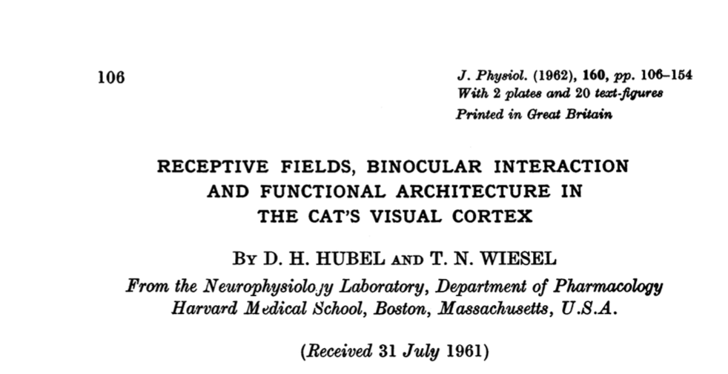
MOTIVATION
Cat experiments in the 60’s: Hubel & Wiesel
[ Video 1 ] [ Video 2 ] [ Paper ]

Slide 4
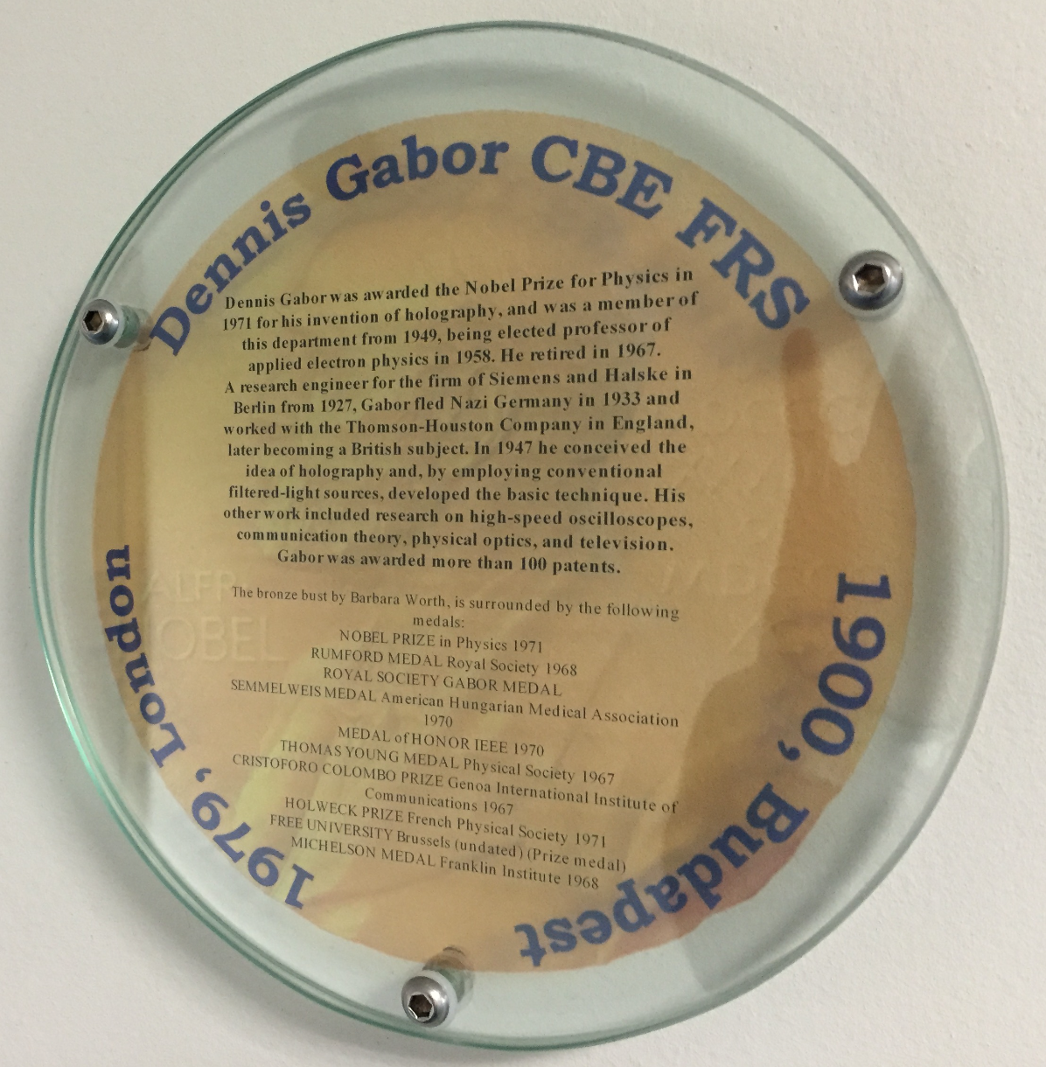
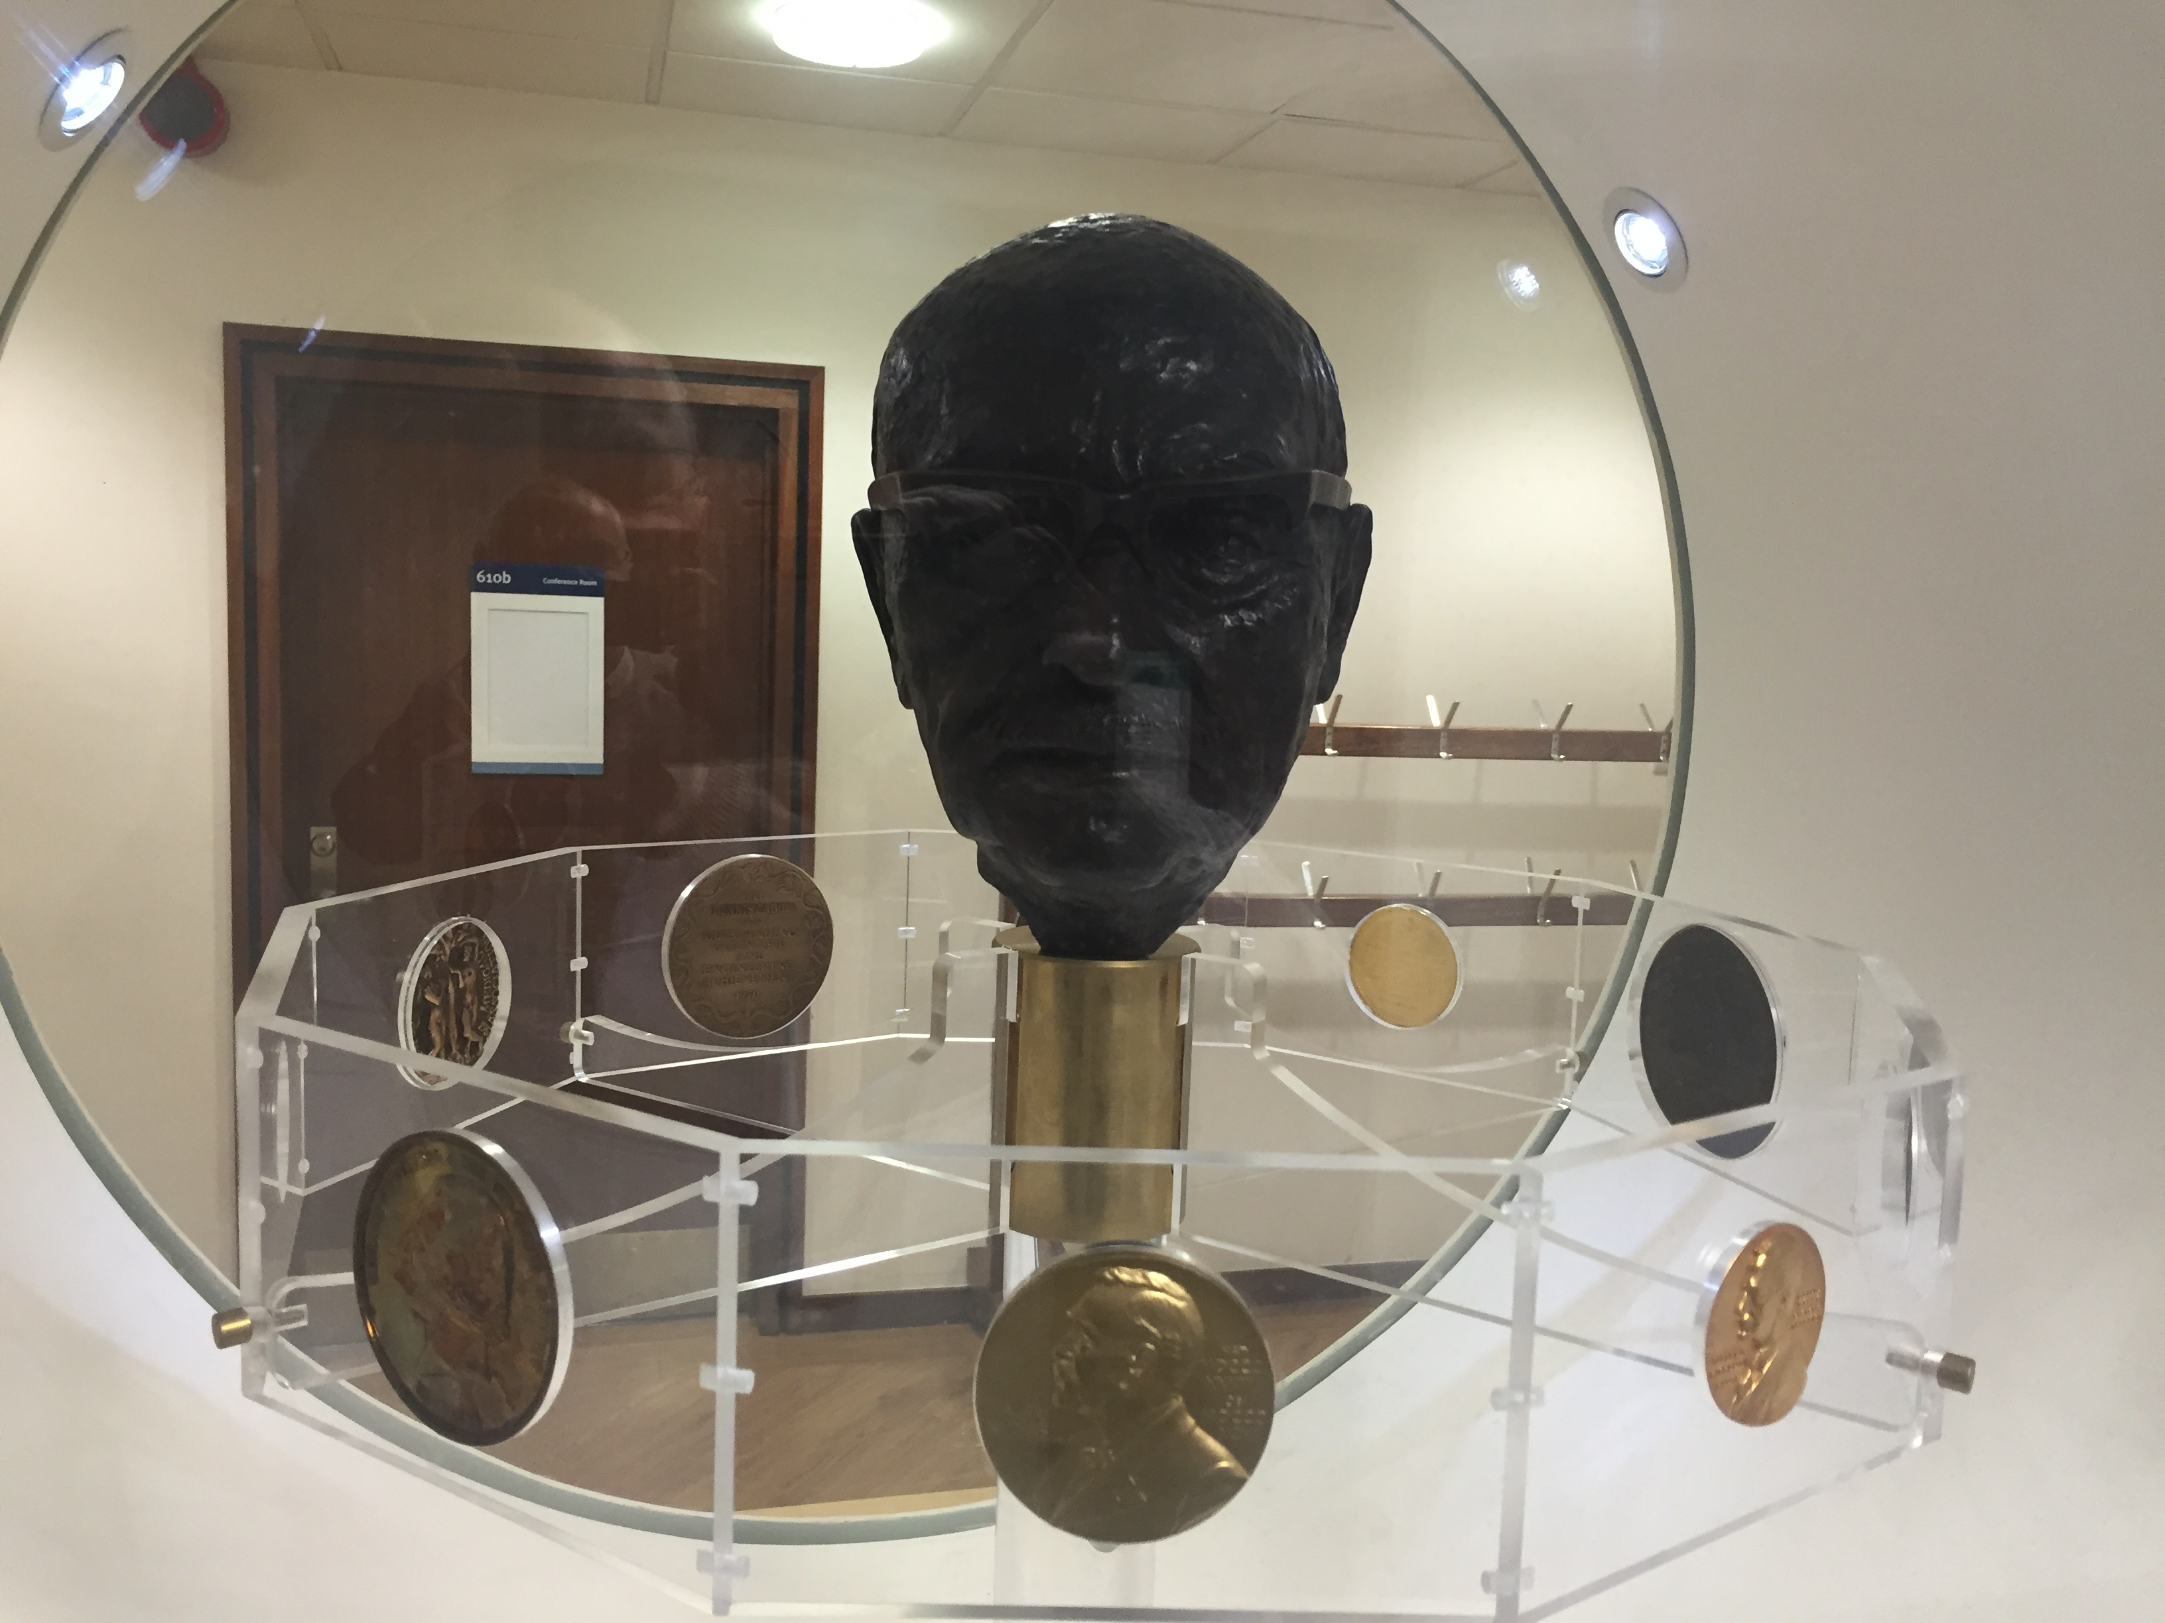
MOTIVATION
Gabor

Slide 5
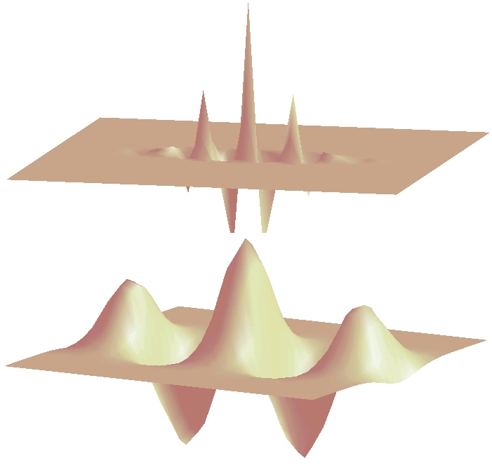
MOTIVATION
Gabor

Slide 6
MOTIVATION
Handcrafted vs. Learned features
LBP, Haralick, Fourier, Gabor, etc.
or
Learned representation from training data

Slide 7
MOTIVATION
Neural networks
x₁
x₂
y
:
:
x_{n}

Slide 8
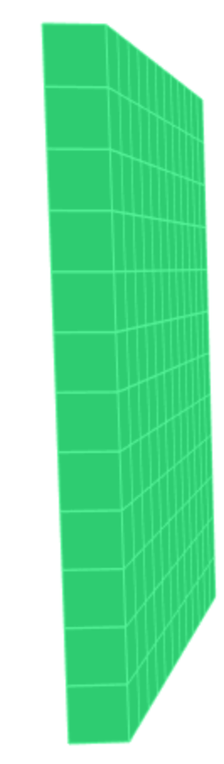

MOTIVATION
What happens if each pixel is an input?
y
How many neurons and weights?

Slide 9
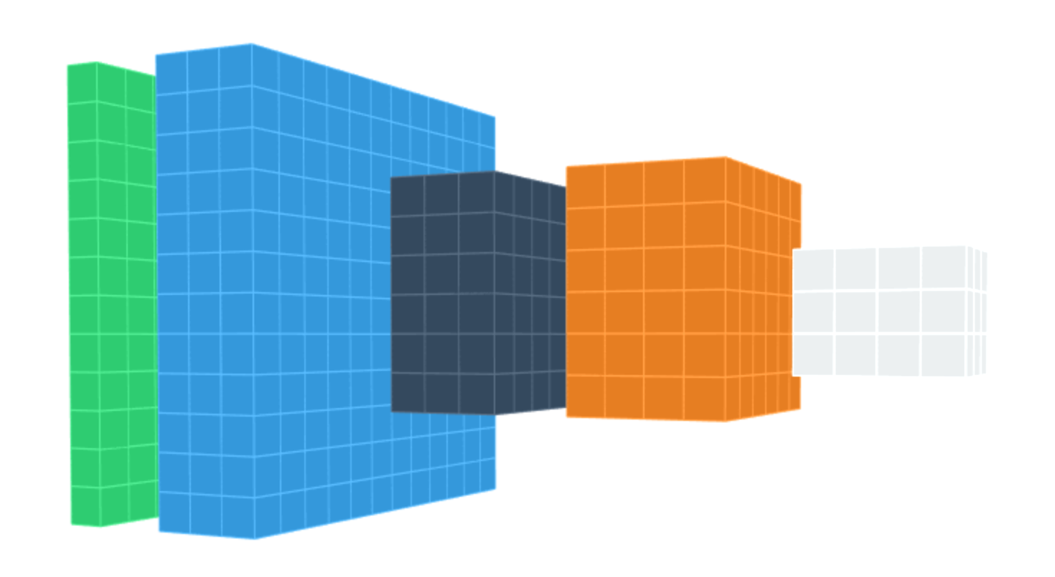
DEEP LEARNING BASICS
Data
representation
Input
image
Layers

Slide 10
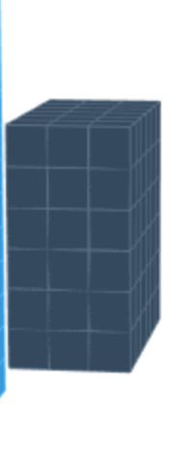
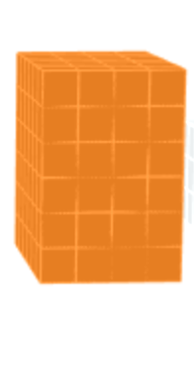
DEEP LEARNING BASICS
Each layer:
f
X
Y

Slide 11
DEEP LEARNING BASICS
f₁
f₂
f₃
f₄
Data
representation
Input
image
Layers

Slide 12
DEEP LEARNING: Typical layers
Convolution layer
Pooling layer
Rectified Linear Unit
Downsampling

Slide 13
DEEP LEARNING: Typical layers
Convolution layer
Pooling layer
Rectified Linear Unit
Downsampling

Slide 14
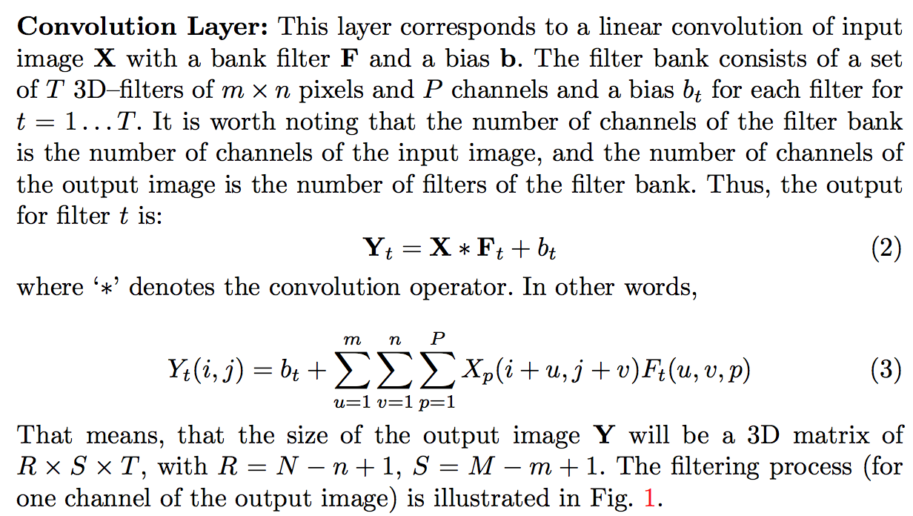
DEEP LEARNING: Convolution layer

Slide 15
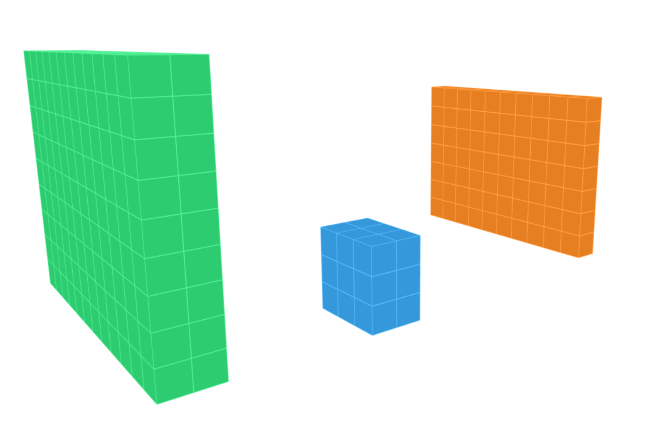
DEEP LEARNING: Convolution layer
X
N-n+1
M
M-m+1
m
N
n
for
P

Slide 16
DEEP LEARNING: Typical layers
Convolution layer
Pooling layer
Rectified Linear Unit
Downsampling

Slide 17
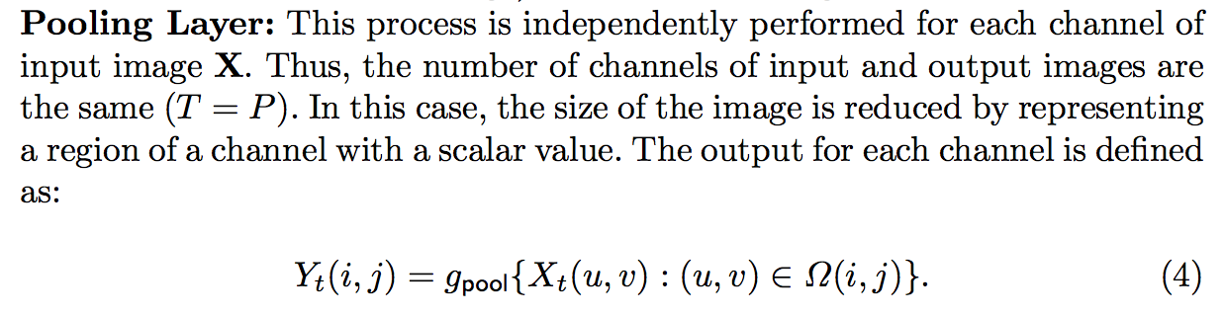
DEEP LEARNING: Pooling layer

Slide 18
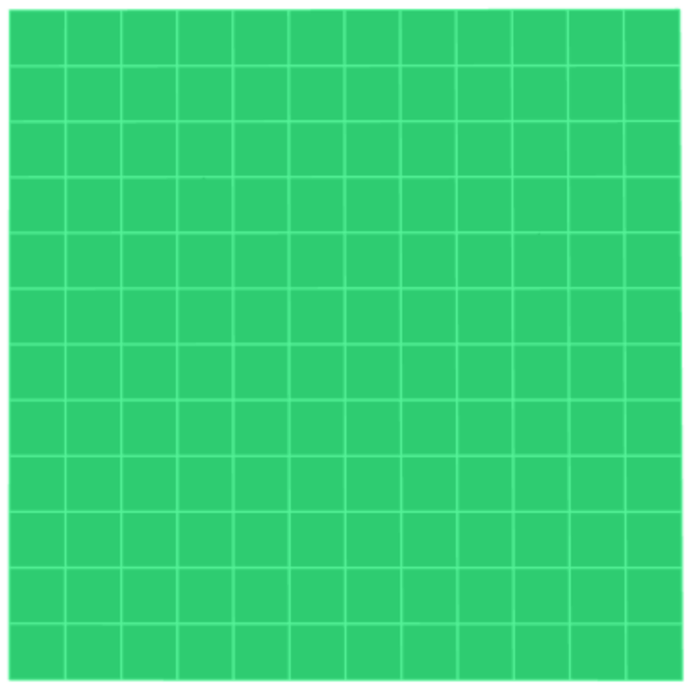
DEEP LEARNING: Pooling layer
max

Slide 19
DEEP LEARNING: Pooling layer
max

Slide 20
DEEP LEARNING: Pooling layer
max

Slide 21
DEEP LEARNING: Pooling layer
max

Slide 22

DEEP LEARNING: Pooling layer
max

Slide 23
DEEP LEARNING: Typical layers
Convolution layer
Pooling layer
Rectified Linear Unit
Downsampling

Slide 24
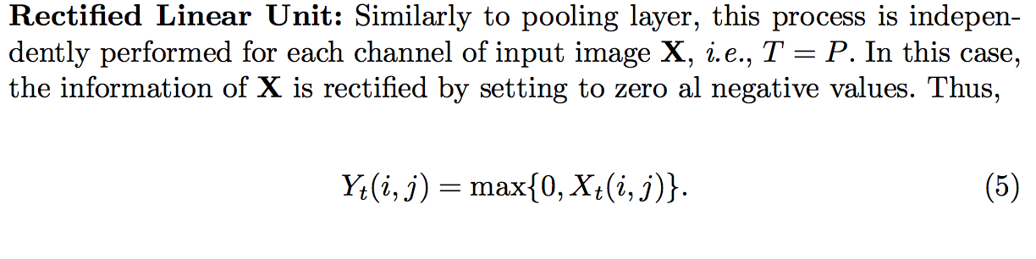
DEEP LEARNING: Rectified Linear Unit (ReLU)

Slide 25
DEEP LEARNING: Rectified Linear Unit (ReLU)

Slide 26
DEEP LEARNING: Typical layers
Convolution layer
Pooling layer
Rectified Linear Unit
Downsampling

Slide 27
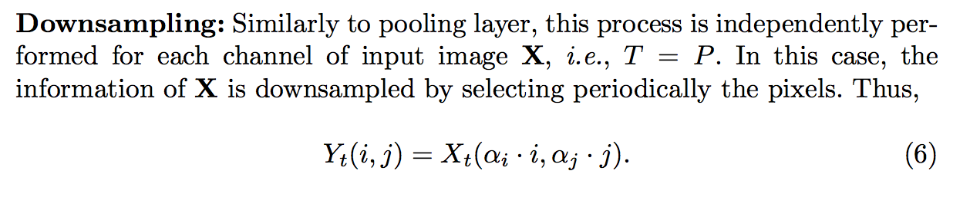
DEEP LEARNING: Downsampling

Slide 28
DEEP LEARNING: Downsampling

